Slide 1
Chips and circuits
By Michiel Pauw, Lennard Visser, Hein Stroomberg

Slide 2
Problem
Morris’ law
Create routes
Optimal routes
visualization

Slide 3
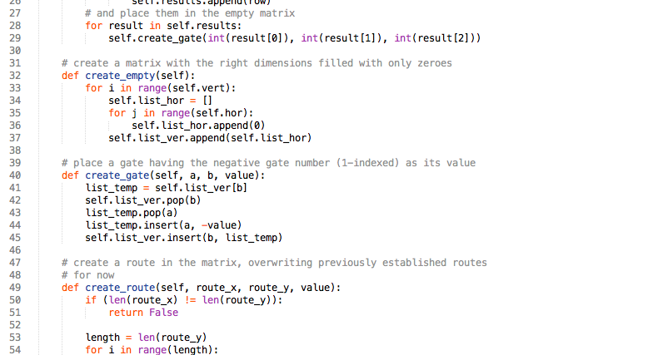
Matrix

Slide 4
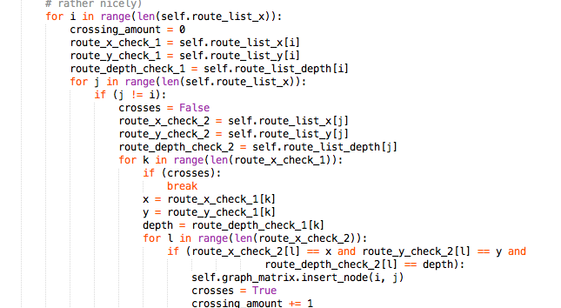
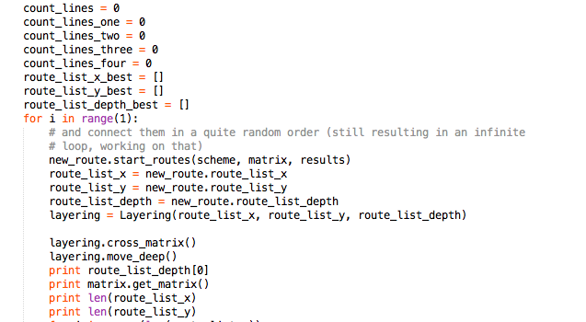
Routes

Slide 5
Routes

Slide 6
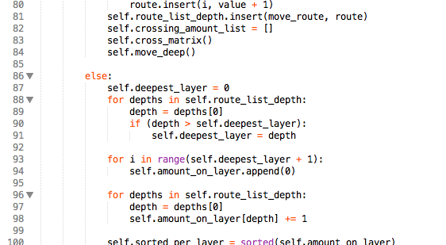
Layers

Slide 7
Algorithms?

